Slide 1
CSS
Cascading Style Seet

Slide 2
CSS Basics Overview
CSS is a stylesheet language that describes the presentation of Web pages

Slide 3
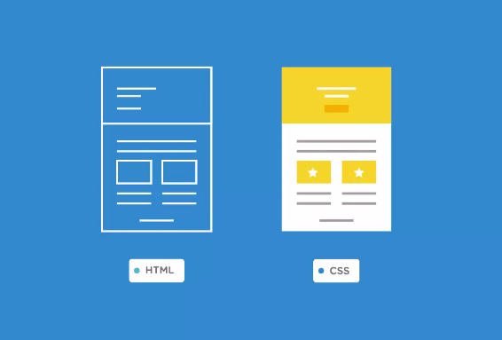
Notes:
HTML is what forms the structural foundation of a Web page.
CSS is what we use to style the HTML with colors, backgrounds, font sizes, layout, and much more.

Slide 4
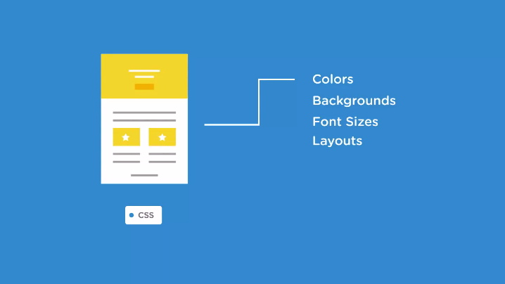
Notes:
CSS is what we use to style the HTML with colors, backgrounds, font sizes, layout, and much more.

Slide 5

Introduction to CSS
Notes:
a Web page is made up of
three different layers that work together to deliver an experience to the user.
There's a content layer, a presentation layer, and a behavior layer.

Slide 6
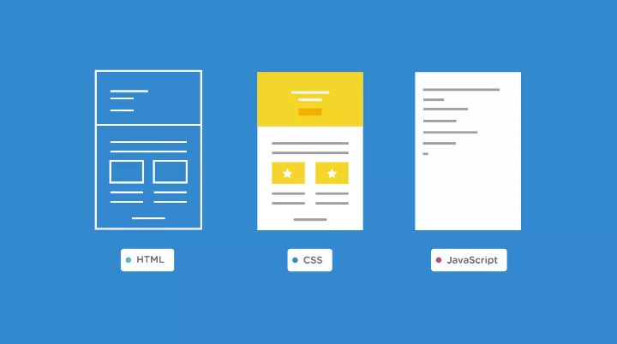
Notes:
HTML provides the content layer, and the behavior layer is normally handled by JavaScript for real-time user interaction, CSS is what handles the presentation layer of a Web page.

Slide 7


Now, over the years, CSS has also improved the accessibility of web content because it's allowed us to adapt our content to various devices, screen sizes, and resolutions.
Notes:
Now, over the years, CSS has also improved the accessibility of web content because it's allowed us to adapt our content to various devices, screen sizes, and resolutions. And what's exciting is that CSS continues to evolve.

Slide 8
There are different ways we can add CSS to a page,
each way has its advantages, or it might have its disadvantages.
So let's review three methods we can use to apply CSS to our pages.
Inline Styles
Internal Styles
External Styles

Slide 9
Inline Styles
when we write inline styles, we write the css in the html file directly inside an elements tag using a style attribute.
we can style any element with any css property, using this in-line style method.
We could style the entire page with this method if we wanted to, but I don't recommend that you do that.
In fact, inline styles are not considered a good practice for developing websites, and they should be used sparingly if at all.
If we need to make any styling changes, it means we need to go inside our html to make those changes.

Slide 10
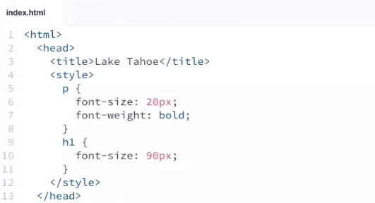
Internal Styles
Internal styles are usually embedded in the head section of the HTML document. And they are defined using the style tag.
Notes:
This code will change the font size bold and larger of all the “p ” tags
And
All h1 size larger.

Slide 11
The internal style sheet method is useful if we're creating a small-scale site, maybe a coming soon holding page, or for temporary use while testing a new feature on our site.
But it's not a best practice for developing websites.
The downside to using this internal style sheet method on larger projects is that because the styles are written inside the HTML file, and there could be tens or hundreds of HTML files depending on the project, the browser has to download the styles each time a new page is loaded.
And it also means that we're duplicating a lot of the same styles across multiple pages, which defeats the real purpose and convenience behind using CSS.

Slide 12
External Stylesheet
The most common and efficient way of adding CSS to a page is with an external stylesheet.
We can change the look of an entire website with just one file.

Slide 13
How to create a Stylesheet
First we'll need to create a stylesheet and that's where we'll write our styles.
Then we're going to name our file style.css.
And to keep our files nicely organize we want to save it in our css folder.
The .css extension is what tells the browser that the file is a stylesheet.
Make sure you always add that .css extension to every stylesheet you create.
We'll need to link the stylesheet to our HTML file.

Slide 14
Link a .css file to HTML
Include the rel attribute.
ts value needs to be stylesheet, because that's what we're linking to.
Add an href attribute and the href attribute is what points to the location of the CSS file.
we need to write the path to the CSS file as css/style.css.

Slide 15
Overview
CSS is a stylesheet language that handles the presentation layer of a web page.
There are three different ways we can add CSS, but the most common and most efficient method is with an external stylesheet that's linked from the head of the document.
The .css file extension is what tells the browser that the file is a style sheet.
The styles written in a style sheet can be shared across multiple web pages.

Slide 16
Quiz

Slide 17
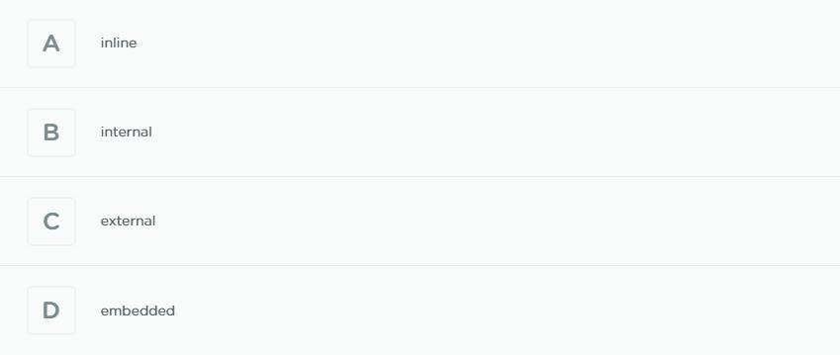
Notes:
External

Slide 18
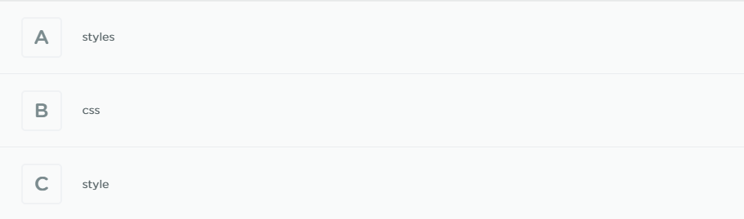
Notes:
Style

Slide 19
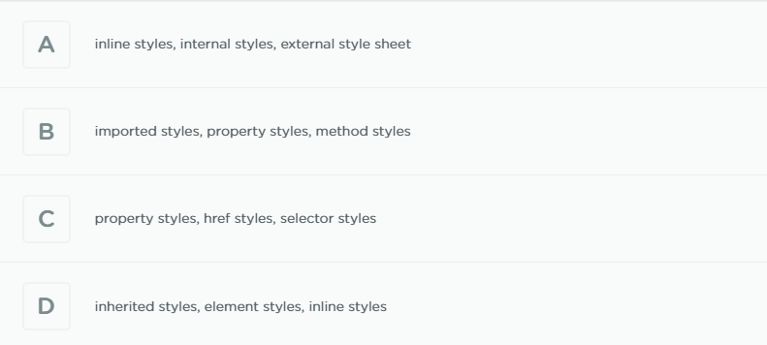
Notes:
A) Inline styles, internal styles, external style sheet

Slide 20
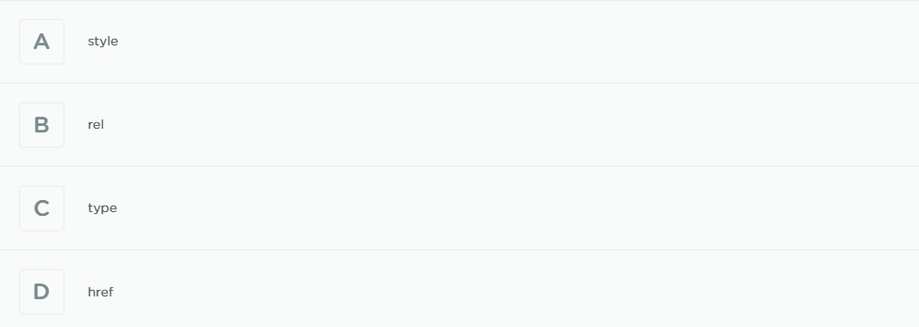
Notes:
B) rel

Slide 21
Notes:
<style>

Slide 22

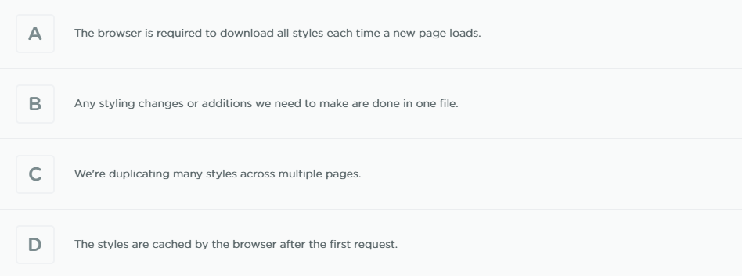
Notes:
The browser is required to download all styles each time a new page loads.

Slide 23
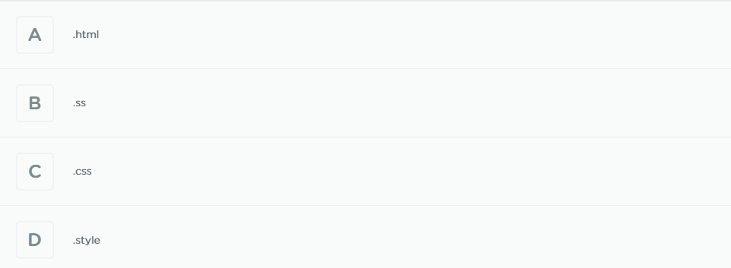
Notes:
C) .css

Slide 24
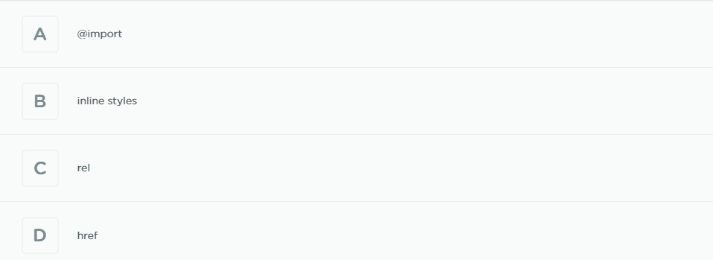
Notes:
A) @import

Slide 25
Intro to Selectors
Selectors are one of the most important and powerful parts of CSS because they let us target the content we want to style. When we define a selector in our stylesheet, we’re instructing the browser to match every instance of that selector in the HTML.
Selectors can be defined based on an element's type, its class or ID attribute, even how we interact with the element, and more.

Slide 26
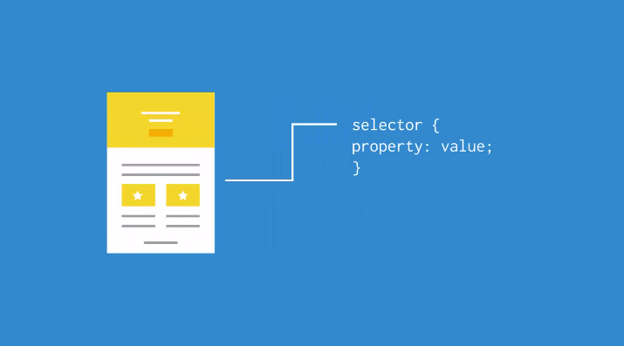
A CSS rule is made up of two main parts, the selector followed by the declaration block. The selector is the part of the CSS rule that targets HTML elements. It's what actually lets us select the content we want to style.

Slide 27
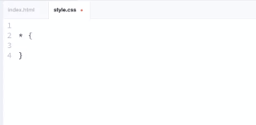
Universal Selector
It is called a universal selector because it selects every element on the page at once and applies the styles we set.
It's a very powerful selector because it overrides all other selectors.

Slide 28
Type Selectors
A type selector is what we use to select an element type on the page.
They're also called element selectors, because we only use the element's HTML tag as the selector.
Notes:
for example, to target every paragraph element in our HTML file, we need to use the p element as our selector.

Slide 29
ID Selectors
An ID selector, lets us assign a unique ID to an element.
That way, we're able to specifically target an element based on its ID attribute.
ID selectors are declared using the pound (#) symbol followed by the ID name.
ID's are unique to the page, so it's important to remember that an element can only have one ID.
A page can only have one element with the same ID name.

Slide 30
Class Selectors
Class selectors let us target elements based on their class attribute. The main difference between a class and an ID selector is that IDs are unique and they’re used to identify one element on the page, whereas a class can target more than one element.
The main difference between a class and an ID selector is that ID's are unique. And they're used to identify one element on the page.
Whereas a class can be used to classify and target more than one element. This makes classes more flexible than ID's.
Classes let us target more than one element with the same class name. In fact, that's one of the biggest advantages to using class selectors.
Multiple elements can share the same class, so we're able to reuse them throughout a page.

Slide 31
Descendant Selectors
CSS also lets us target elements based on their relationship in the HTML document.
For instance, we can combine selectors to create what's called a descendent selector, because it targets an element that's a descendent of another element.
This makes our selectors more specific.

